Slide 1
Online notes app (Justnote)
CSE0318 SOFTWARE ENGINEERING
Saber Ahmed
Ug02-44-17-006

Slide 2
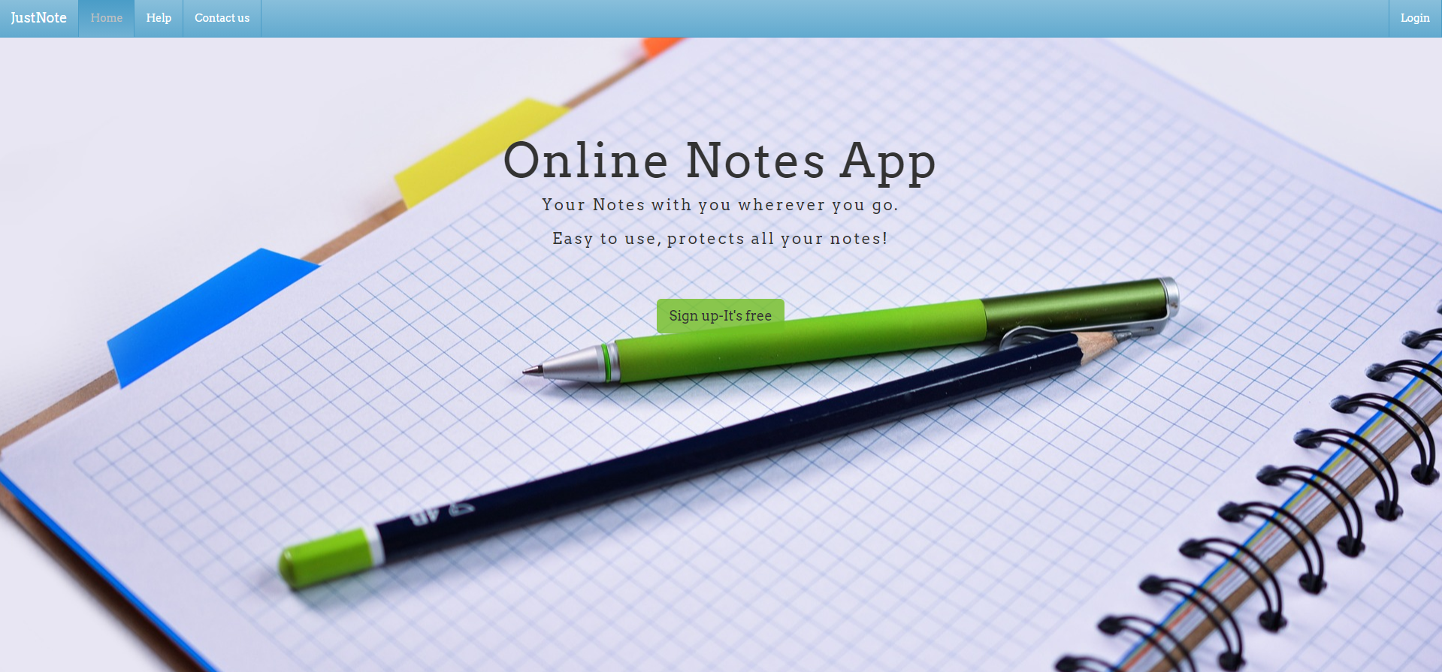
Landing page:

Slide 3
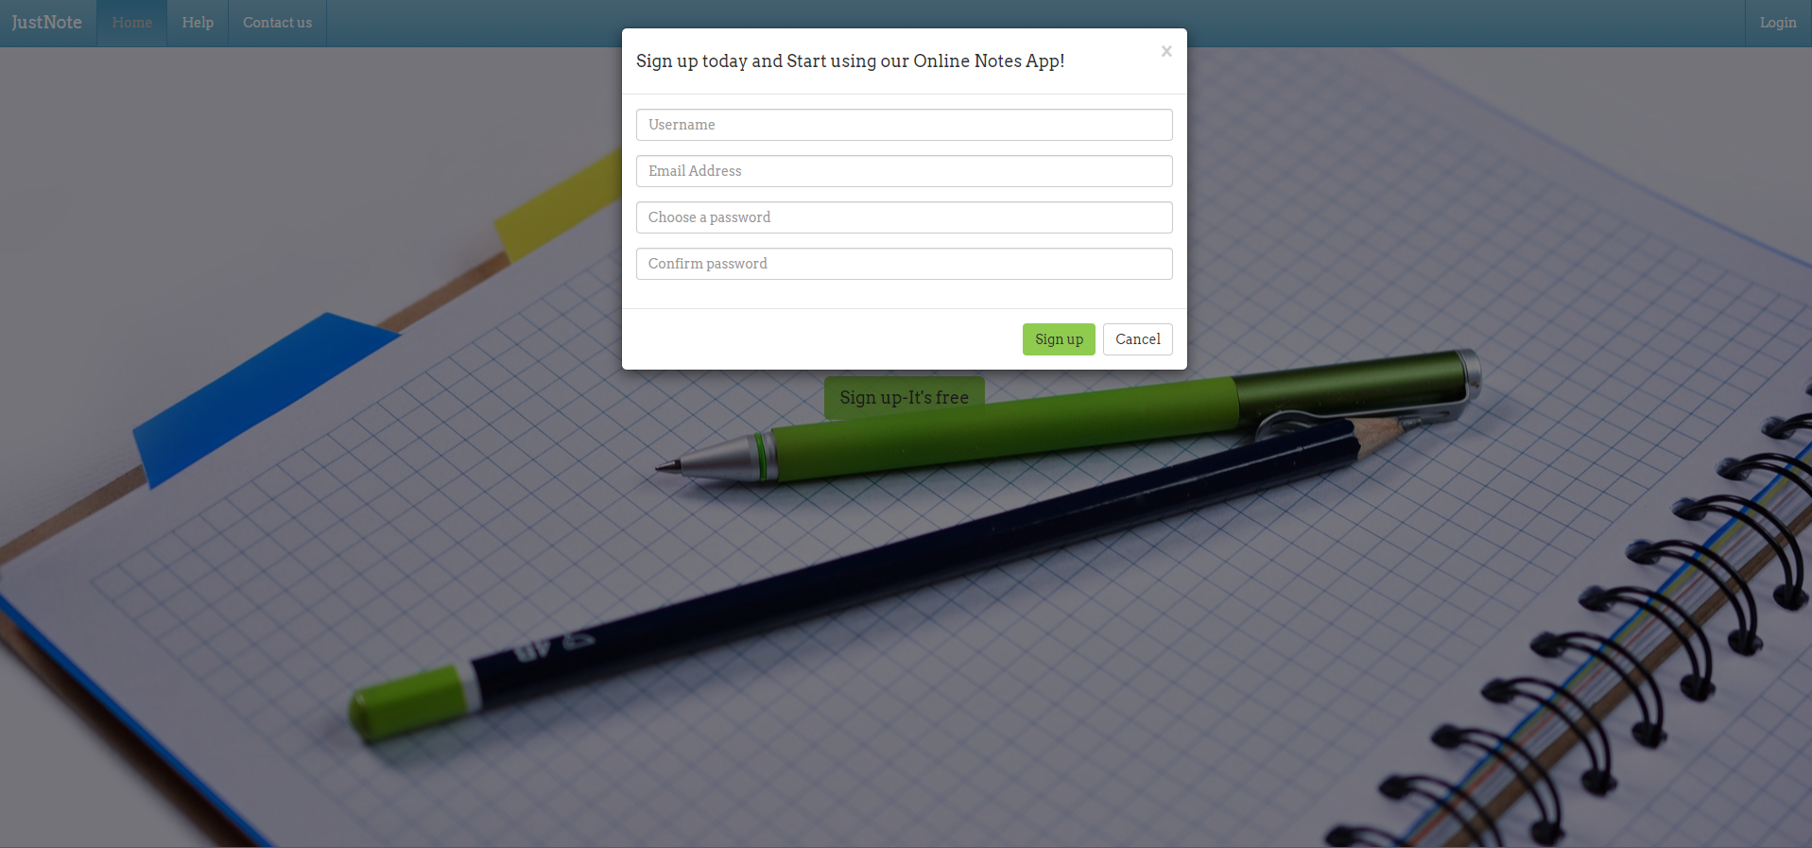
Sign up:

Slide 4
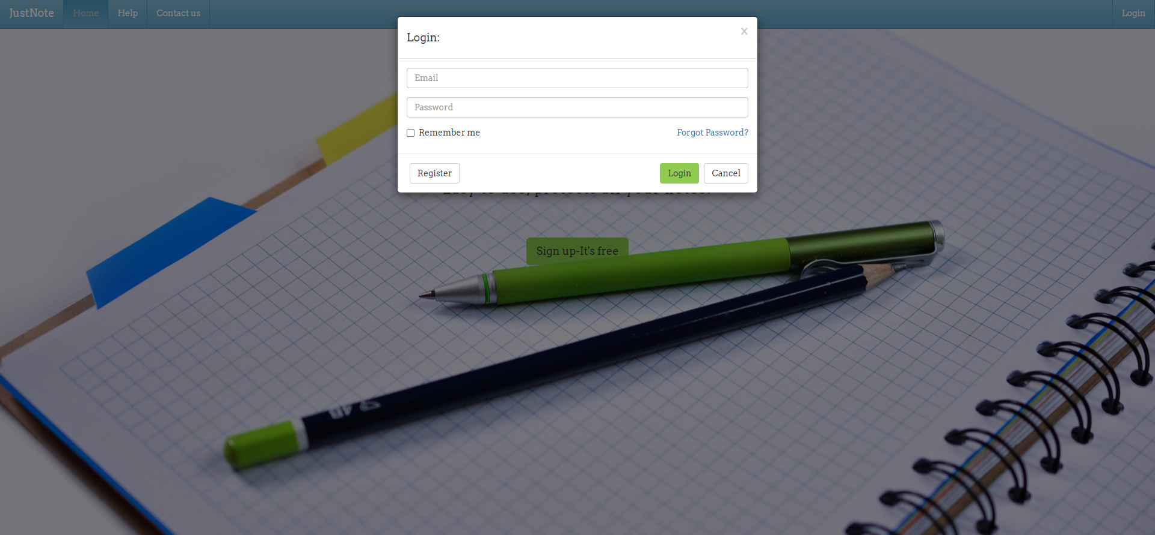
Login:

Slide 5
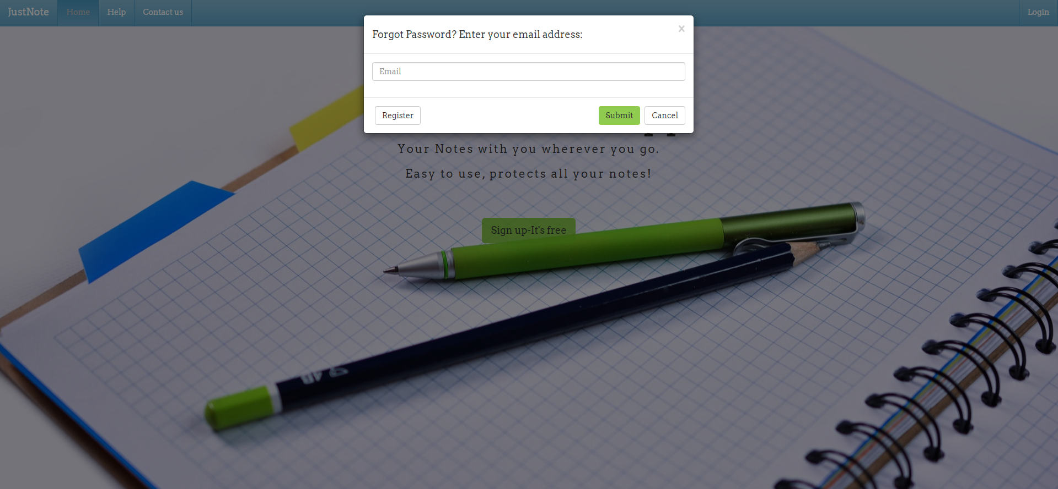
Forgot password:

Slide 6
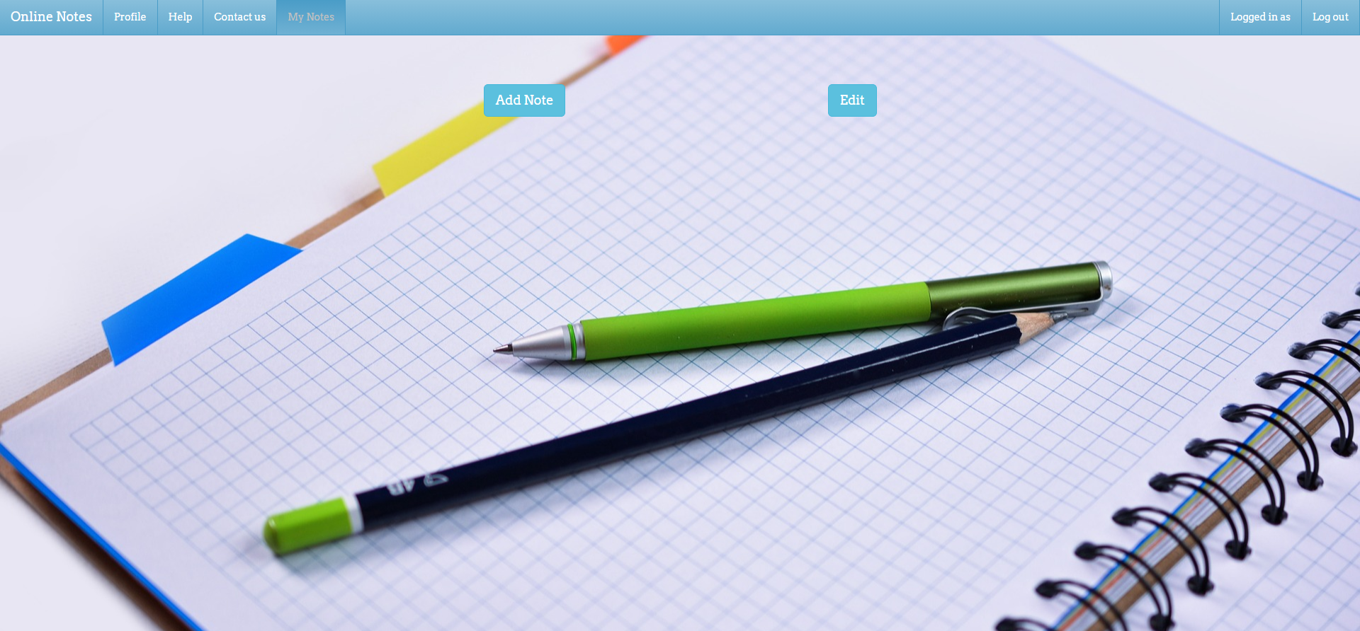
My notes page:

Slide 7
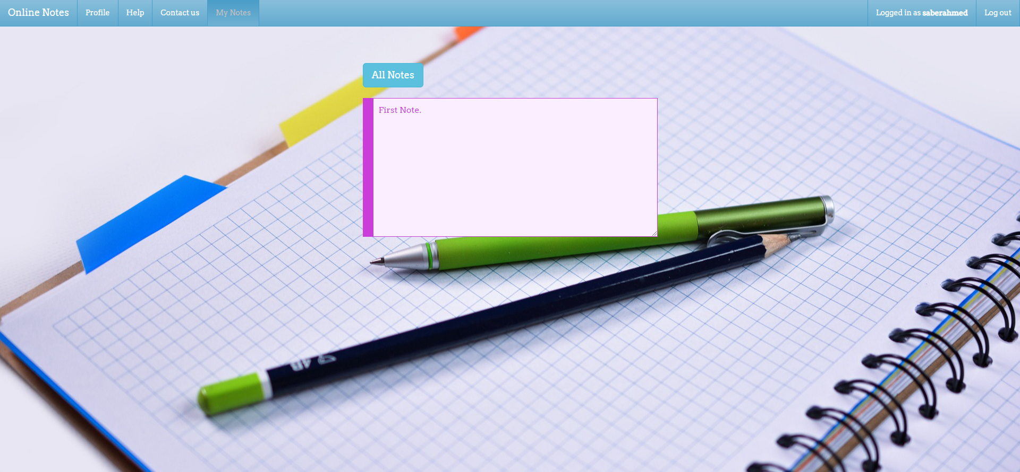
Add notes:

Slide 8
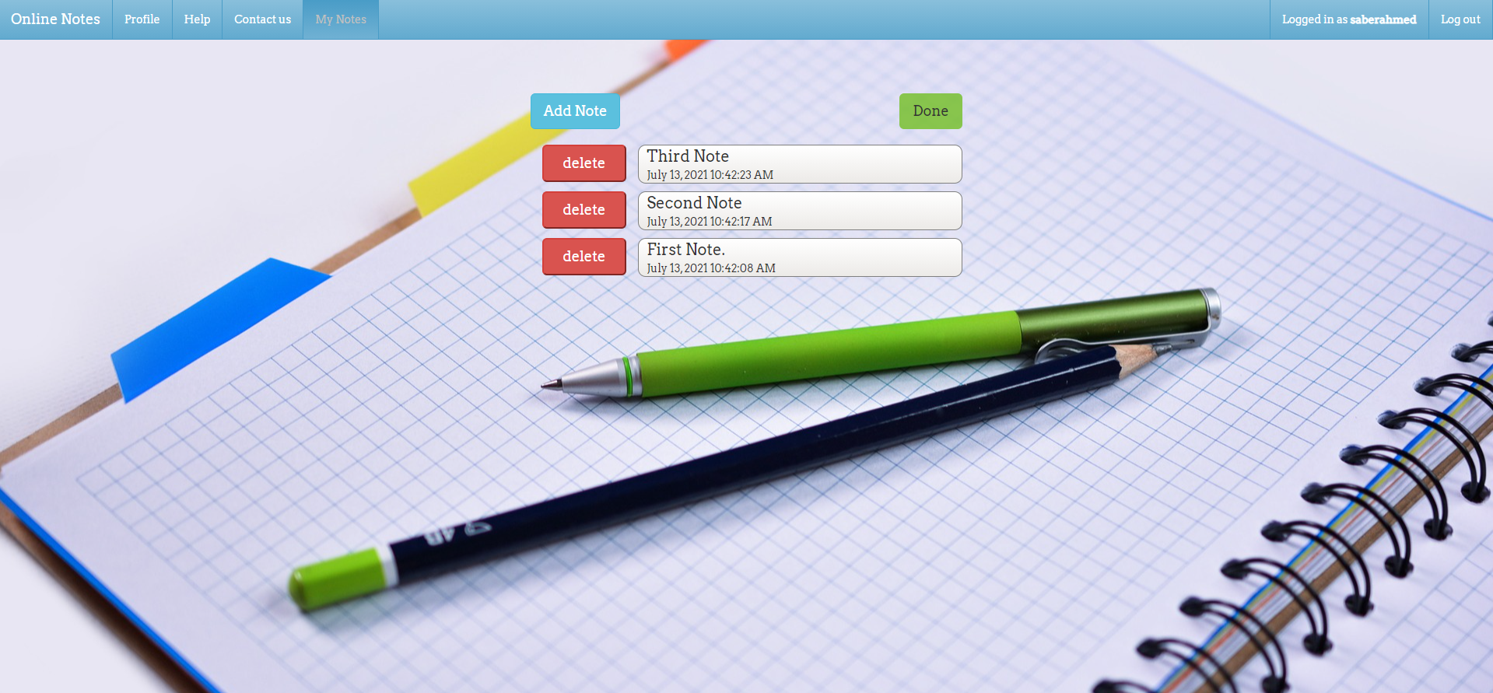
Edit notes:

Slide 9
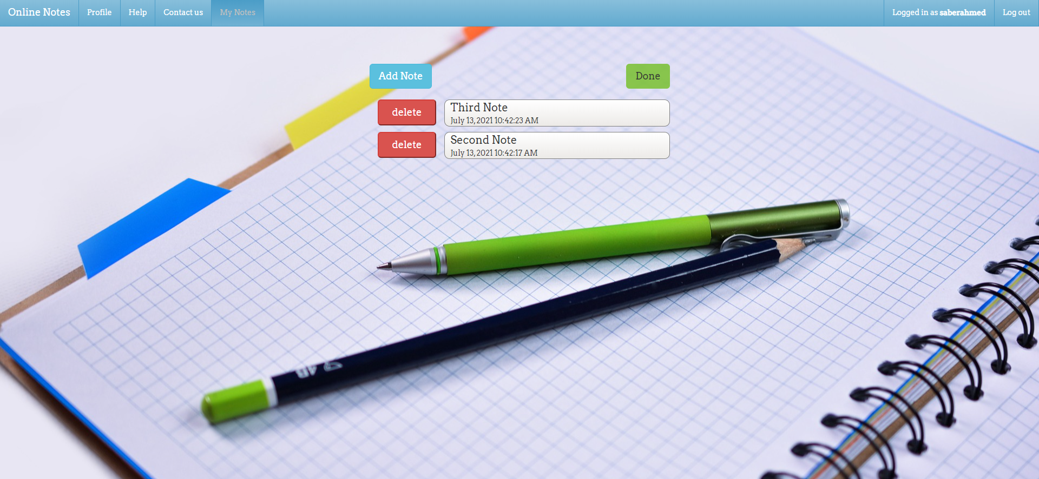
Delete notes:

Slide 10
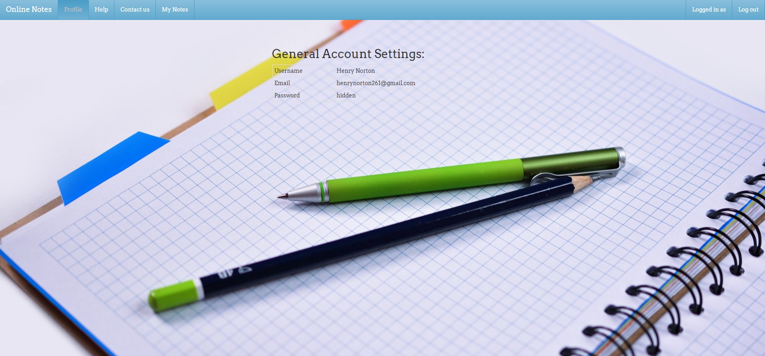
Profile:

Slide 11
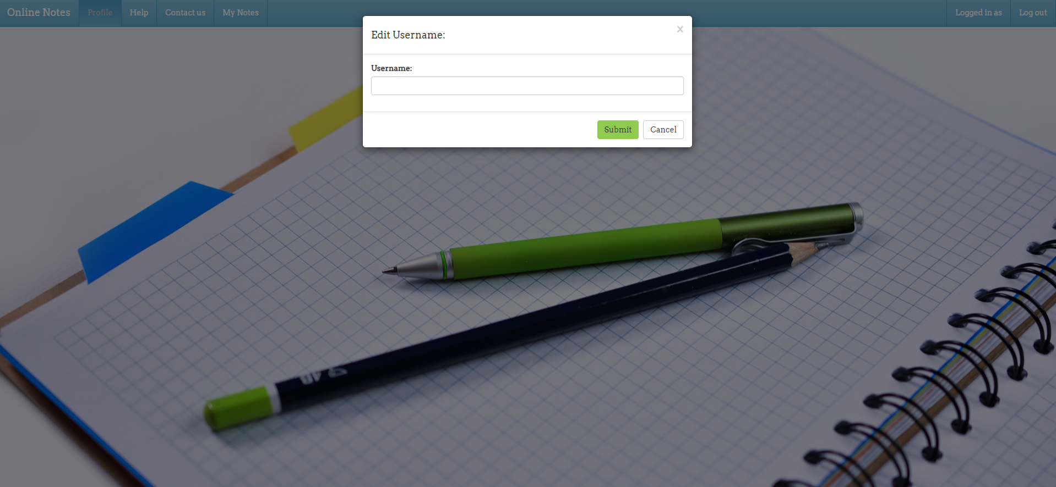
Edit username:

Slide 12
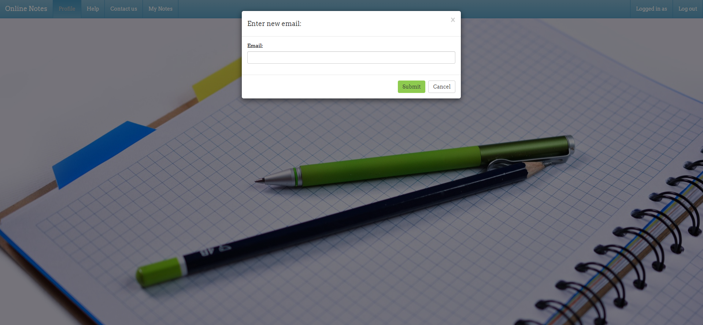
Update email:

